Slide 1
HTTP and Servers
101 on how the internet works

Slide 2
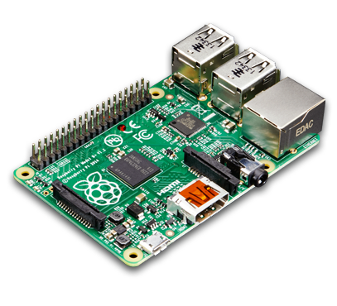
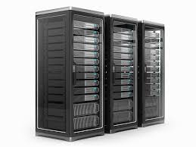


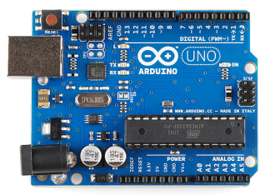

What is a Server?
Any “Computer” with a way to store data, run processes, and can connect to other computers can be a Server
Raspberry Pi is a “Full Computer”
Difference between a Raspberry Pi and my Laptop is the performance it can handle

Slide 3
How do I run a server
You should use a Server Framework that handle request at a high level.
People have spent years working on them, they are good, so use them.
…But today you will learn how to create your own server on a single socket that parses the text of the string.
Hey, someone needs to understand how it works

Slide 4
How do I talk to the server
You can send anything you want at a server if you have the IP address, but there are standard Protocols that are agreed on otherwise I wouldn’t know what format the information you are sending is sent in
HTTP
Stands for Hypertext Transfer Protocol
Way of sending text to servers and getting a response back from them
This literally is what the Internet/world runs off of

Slide 5
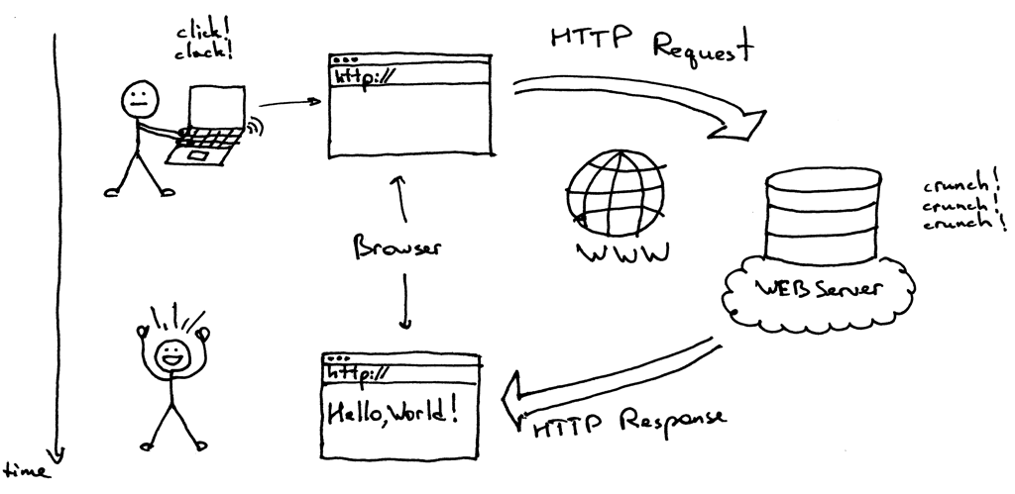
How you are use to talking to servers
Main idea is a Client sends a Server a HTTP Request where the server does its thing and sends back a HTTP Response to the Client
This HTTP Response can be the HTML to a website, info that the server executed its job correctly or hit an error, it could send you back a joke in plain text, its all up to the server (also known as back-end code)

Slide 6
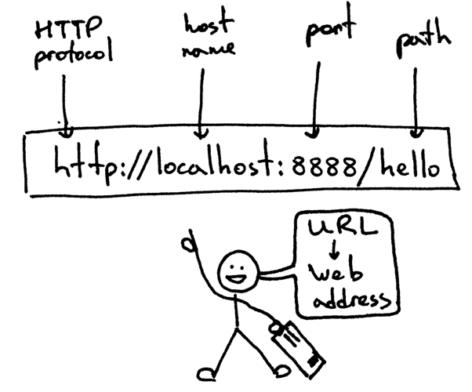
How to message the server
We use a URL
This just tell what server to find and where in the server to send the message
Can be used in a Web Browser, Dev tool (Postman), or a custom made client request from your Raspberry Pi

Slide 7
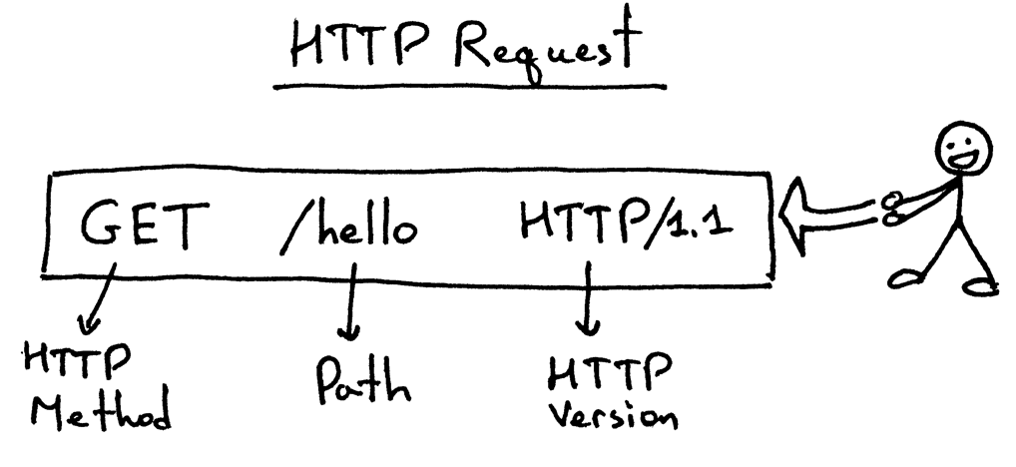
The Request
Many methods
We will stick to just GET and POST
Path is structured like Linux file location
HTTP 1.1 is old and still going strong

Slide 8
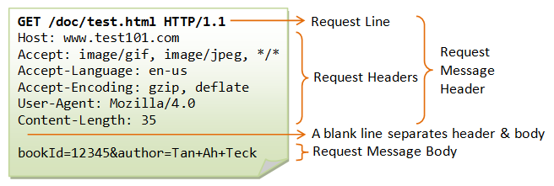
The Request - Header
Server first reads Request Line
Header information is where we can send details in a “Key-Value” fashion
Everything is separated by new lines

Slide 9
The Request – Verb types
Verbs indicate DESIRED actions, its still up to server to handle, but there are some set standards
GET
All information is in URL/Request Line
http://myServer:8888/path/with/info/about/the/get/call
Server might have parameters set depending what you put on a specific part of a path
POST
Lets server know you are sending a Body with the request in JSON format
This is used to send larger amount of data

Slide 10
JSON? Ok quick 2 minute detour
JavaScript Object Notation
Way of holding data in a “Key-Value” fashion
Similar to Structs in C/C++
Var example = { “Name” : “Spencer”, “Age” : 21, “isFunny” : false }
example.Name == “Spencer”
example.Age == 21
example.isFunny == false
“Name”, “Age”, “isFunny” are the Keys
“Spencer”, 21, false are the Value and can be any type

Slide 11
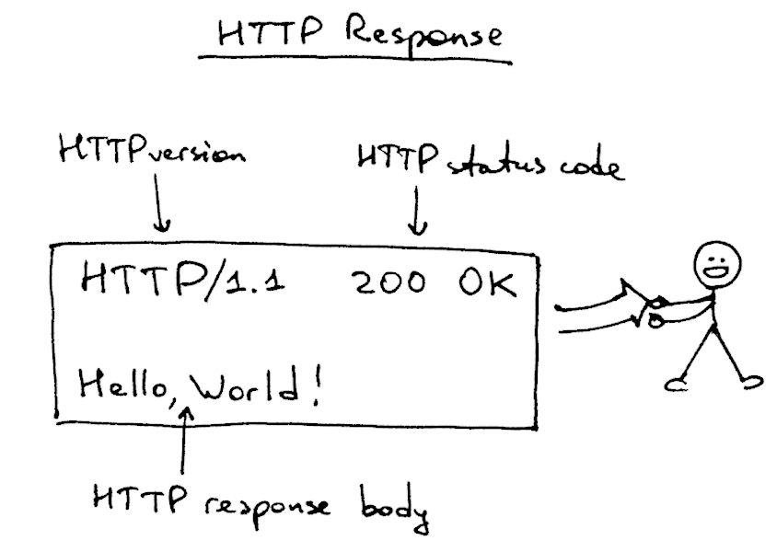
The Response
The server will decide what it will do and send back a response
If it doesn’t the client will be in a infinite loop waiting

Slide 12
The Response – Status Code
Status Codes are one of those things where you writing your server can send back any number. There a very standard number system… so don’t go crazy
Status codes to know:
200 OK - “I got your request and did something” but doesn’t mean it “Correctly” did it
400 Bad Request – The Client screwed up what it sent
404 Not Found - it couldn’t find the path you sent it
500 Internal Server Error – The Server screwed up what it was trying to do

Slide 13
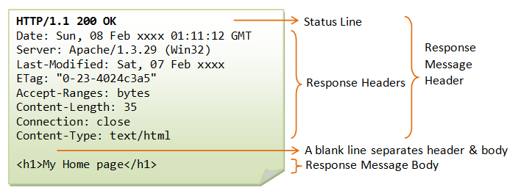
The Response – Looks like the Request
Same format as the Request
Can you smell the string parsing yet?

